Slide 1
Adding & manipulating columns

Slide 2
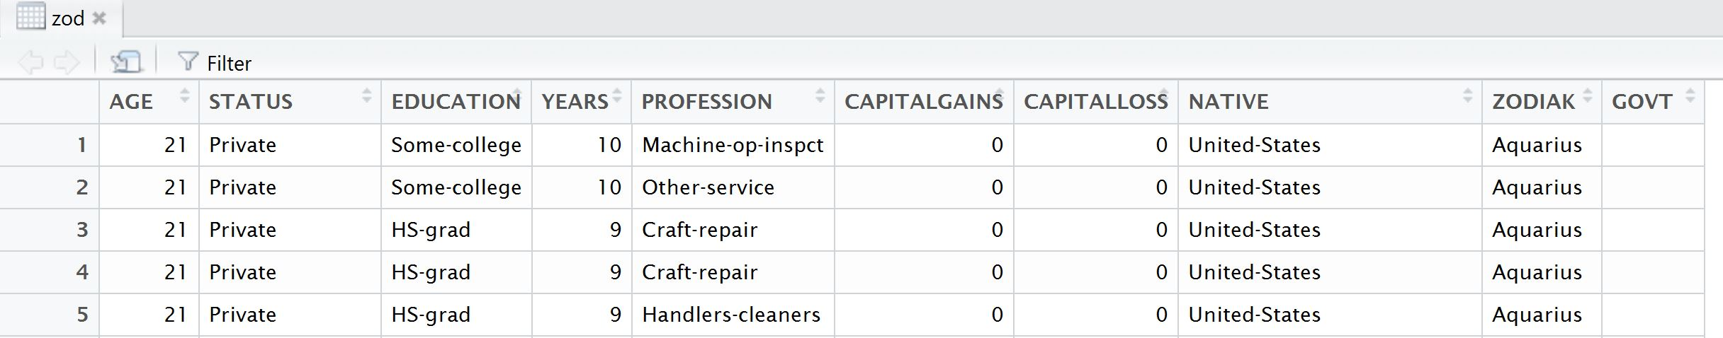
Adding a new column
Adding a new column:
zod[,10] <- ""
Changing name of column:
colnames(zod)[10] <- "GOVT"

Slide 3
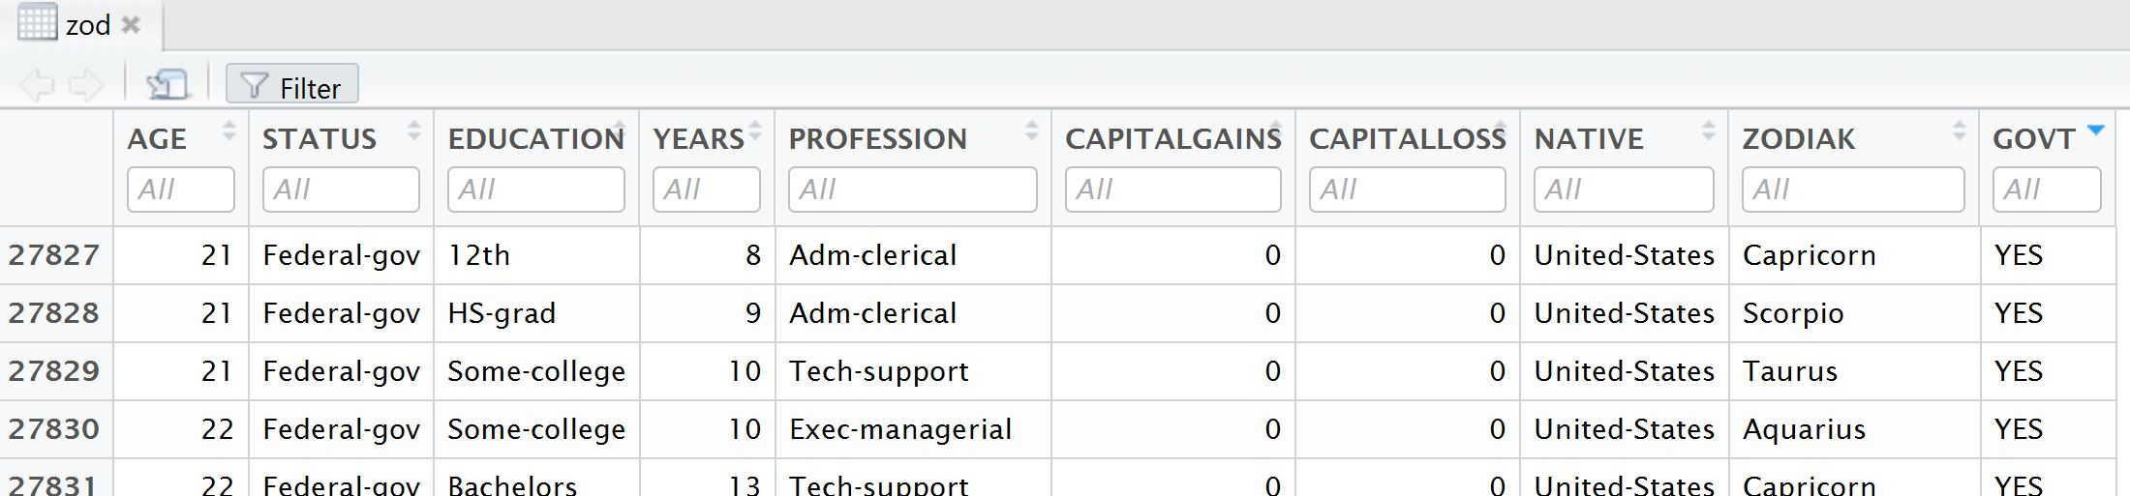
Populating column data
Using single condition:
zod[zod$STATUS == "Federal-gov",10] = "YES"
Combining multiple conditions:
zod[zod$STATUS == "State-gov" | zod$STATUS == "Local-gov",10] = "YES"

Slide 4
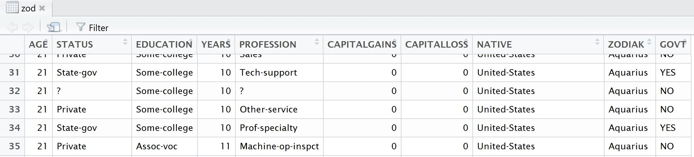
Contd…
Manipulating one column’s own data:
zod[zod$GOVT != "YES",10] = "NO"
http://data101.cs.rutgers.edu/laboratory/pages/charactercategory

Slide 5
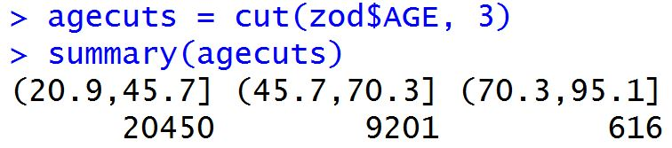
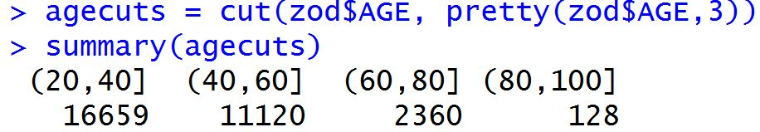
Range, Cut, Summary
http://data101.cs.rutgers.edu/laboratory/pages/numericalcategory
To find range of values in a column:
range(zod$AGE)
To make equal interval cuts:
agecuts = cut(zod$AGE, 3)
agecuts = cut(zod$AGE, pretty(zod$AGE,3))
summary(agecuts)
This will show the distribution among the groups formed.
Note that 3 cuts make 3 groups,
BUT use of pretty() can make
different number of groups

Slide 6
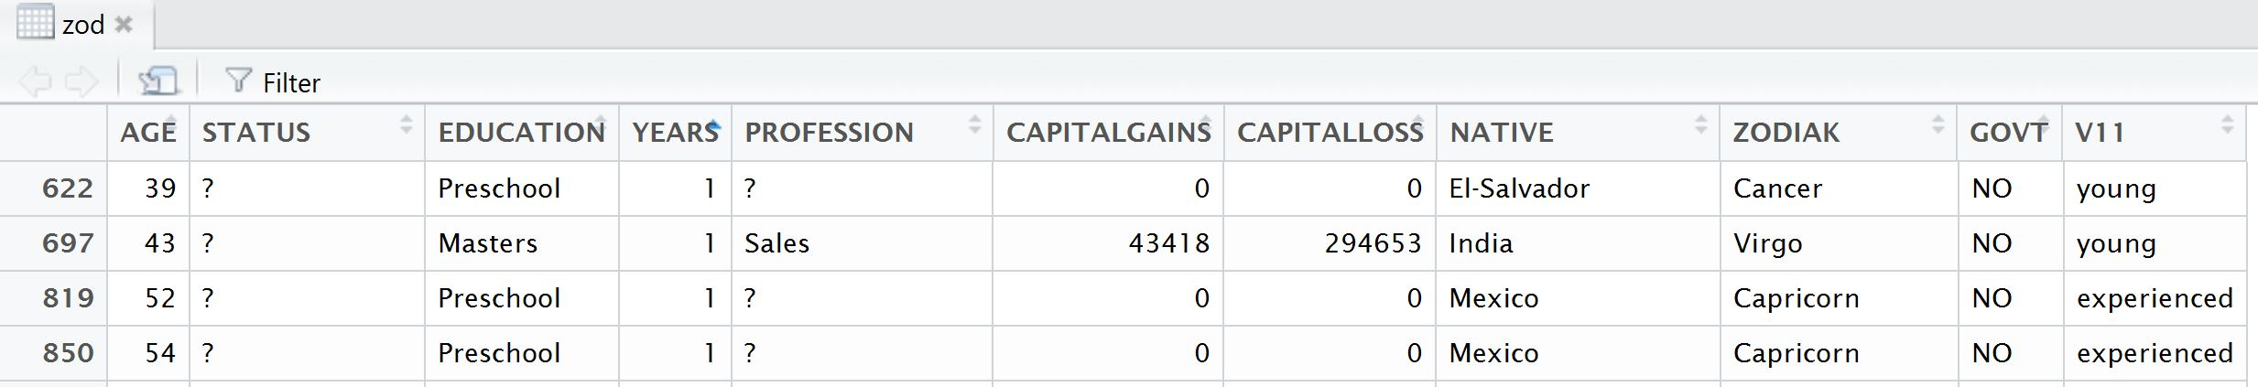
Contd…
This can be used to create a new column with the age groups classification:
zod[,11] = cut(zod$AGE, pretty(zod$AGE,2), labels = c("young","experienced"))

Slide 7
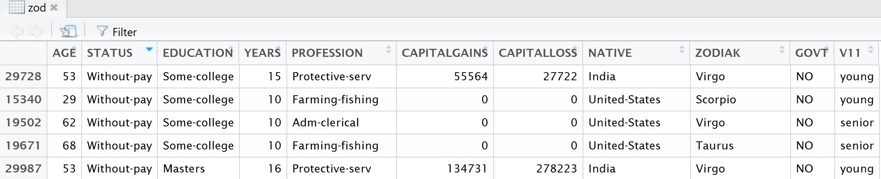
Defining breakpoints
To make your own intervals
To make 2 intervals, below 60 and above 60:
zod[,11]= cut(zod$AGE,breaks=c(20,60,100),labels = c("young", "senior"))

Slide 8
Using %in%
To replace all Education fields below HighSchool with HS:
Find list of education “categories”:
unique(zod$EDUCATION)
Create a list with below HS education:
HS.list = c("1st-4th", "5th-6th", "7th-8th", "9th", "10th", "11th", "12th", "HS-grad")
Add a new column with values matching with HS.list data replaced with “HS”:
zod[zod$EDUCATION %in% HS.list,12] = "HS"
OR replace existing data with:
zod[zod$EDUCATION %in% HS.list,3] = "HS"

Slide 9
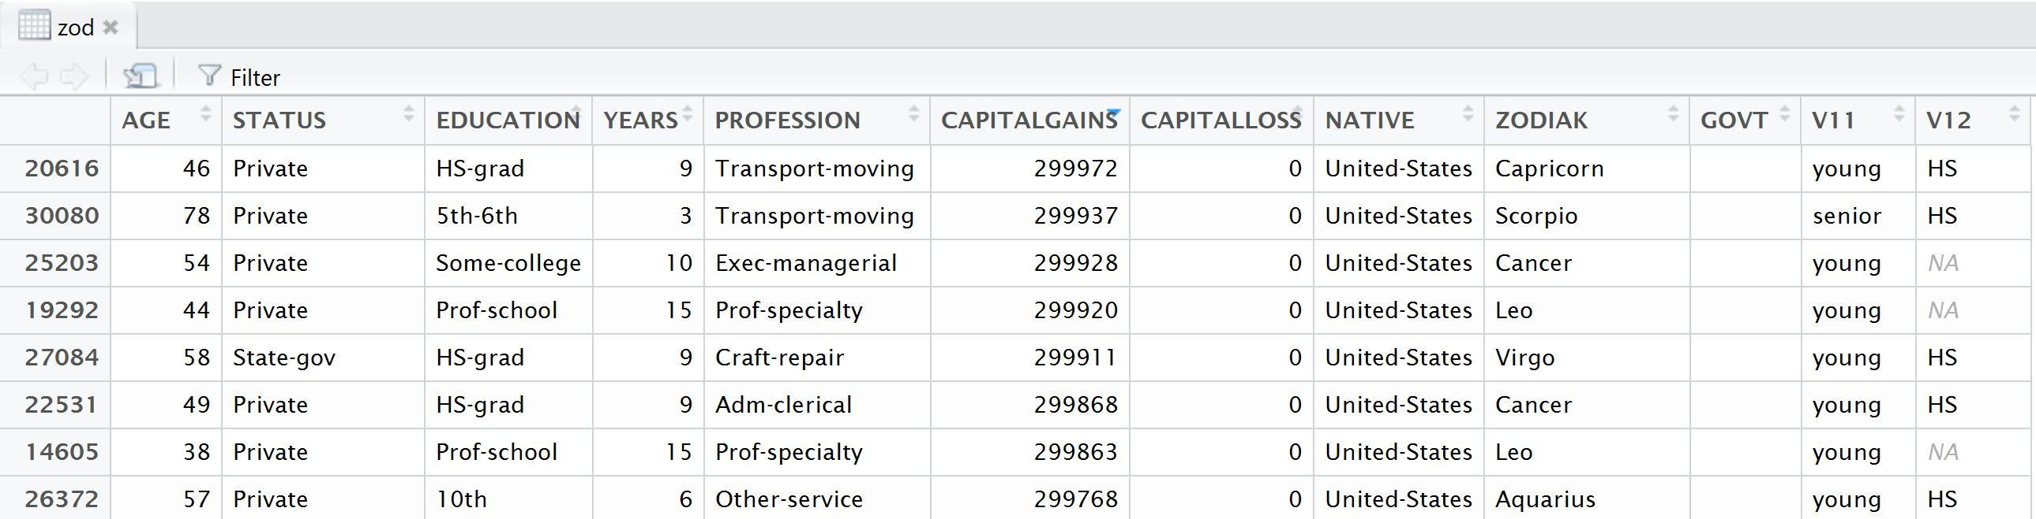
Contd...

Slide 10
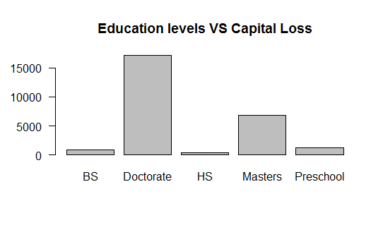
Some interesting results
loss.mean = tapply(zod$CAPITALLOSS,zod$EDUCATION,mean)
barplot(loss.mean, las = 1 , main = "Education levels VS Capital Loss")
How higher educated people tend to take higher risks, resulting in higher capital losses

Slide 11
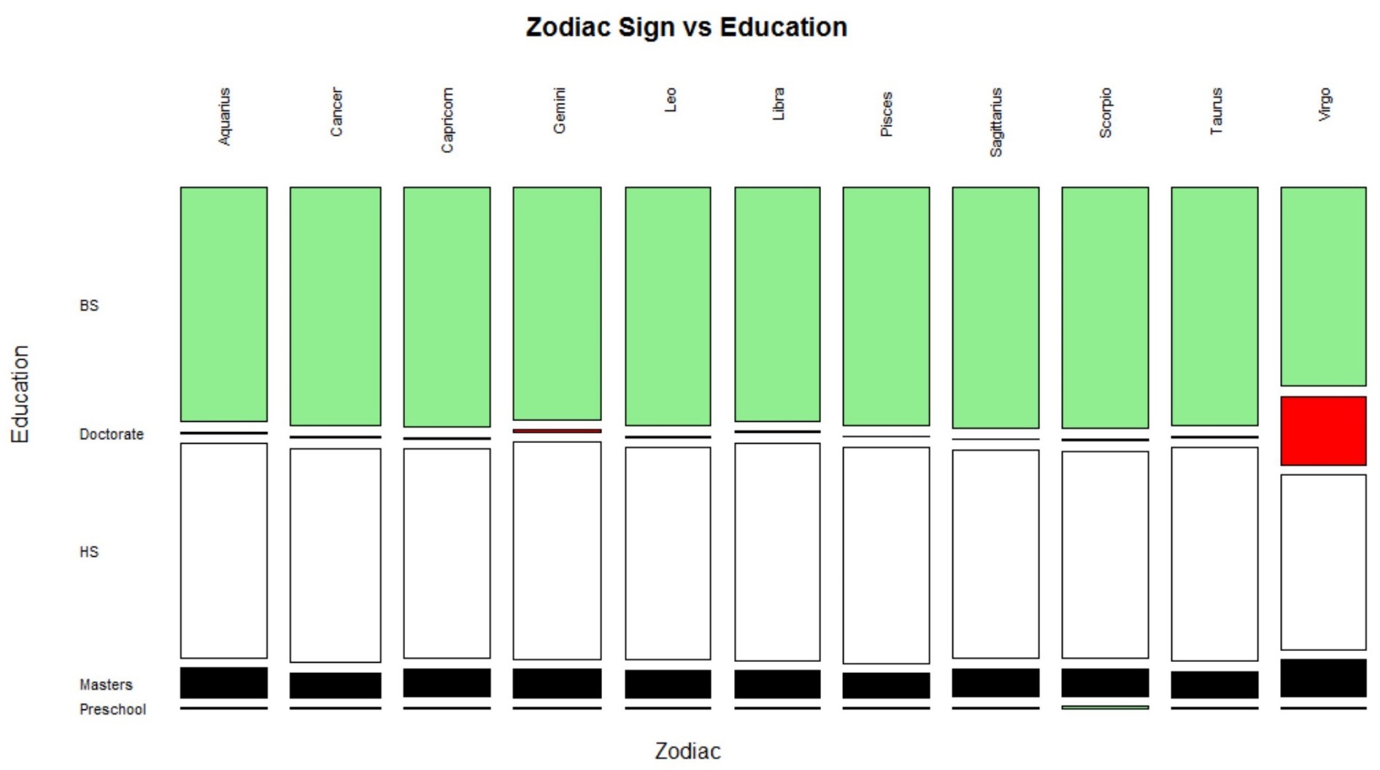
mosaicplot(zod$ZODIAK~zod$EDUCATION,las = 2, col = c("light green","red","white", "black"),
main = "Zodiac Sign vs Education", xlab = "Zodiac", ylab = "Education")

Slide 12
References
http://data101.cs.rutgers.edu/laboratory/pages/numericalcategory
http://data101.cs.rutgers.edu/laboratory/pages/charactercategory

